Slide 1




REGRESSION METRICS

Slide 2
REGRESSION METRICS
To evaluatehowgoodaregressionmodel is, i.e, how
close the predicted values are to the actual values
R Squared
Mean Absolute Error (MAE)
Mean Squared Error (MSE)
Root Mean Squared Error(RMSE)

Slide 3
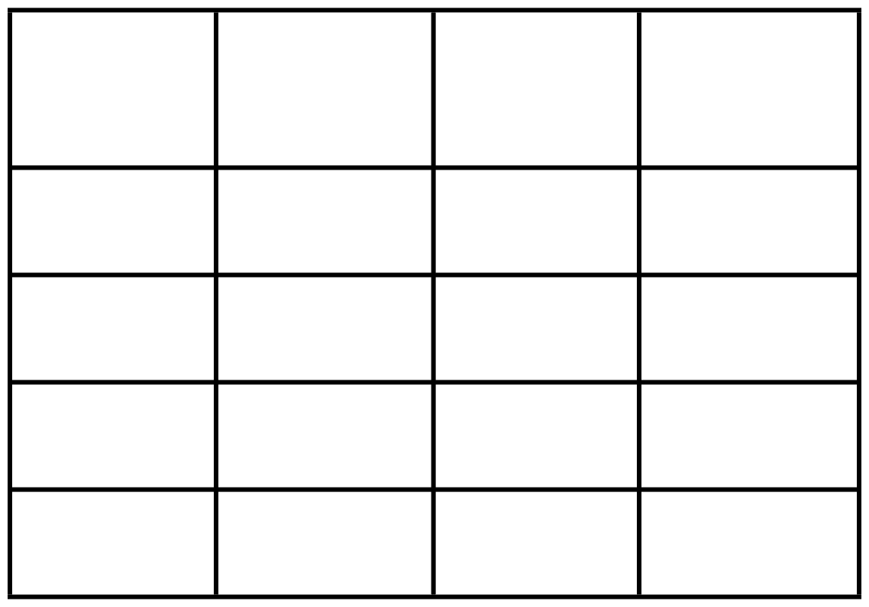

Tv Ad Budget
Actual Sales
Predicted Sales
Mean Absolute Error - MAE ⟶ average of absolute differences between actual and predicted values.
50K
14
13.5
100K
28
30
80K
22
21
120K
35
32
Actual Sales
Predicted Sales
yt - yp
|yt - yp|
14
13.5
0.5
0.5
28
30
-2
2
MAE = 6.5/4 = 1.625 If your model is predicting closer to the actual value, It’s doing well.
22
21
1
1
35
32
3
3

Slide 4

Tv Ad Budget
Actual Sales
Predicted Sales
Mean Squared Error - MSE ⟶ average of Squared differences between actual and predicted values.
50K
14
13.5
100K
28
30
80K
22
21
120K
35
32
Actual Sales
Predicted Sales
yt - yp
(yt - yp)²
14
13.5
0.5
0.25
MAE = 14.25/4 = 3.5625
28
30
-2
4
Similarto MAE,but squares the error before
22
21
1
1
averaging. so, large errors are punished more.
35
32
3
9

Slide 5
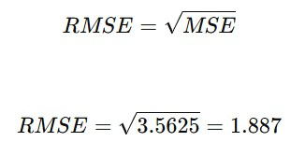
ROOT MEAN SQUARED ERROR (RMSE)
Square root of MSE - Brings the error back to original units.

Slide 6


Predicted (y^)
Step 1: Calculate Mean of Actual values y_mean = 10+12+15+18+20/5
Actual (y)
10
9
= 75/5 = 15
12
11
15
14
18
17
Predicted (y^)
Actual (y)
SS_tot
SS_res
20
19
10
9
(10-15)^2
(10-9)^2
SS_tot = 25+9+0+9+25
= 68
12
11
(12-15)^2
(12-11)^2
SS_res = 1+1+1+1+1
15
14
(15-15)^2
(15-14)^2
= 5
18
17
(18-15)^2
(18-17)^2
R2
= 1 - 5/68 = 1 - 0.0735
= 0.926
20
19
(20-15)^2
(20-19)^2

Slide 7


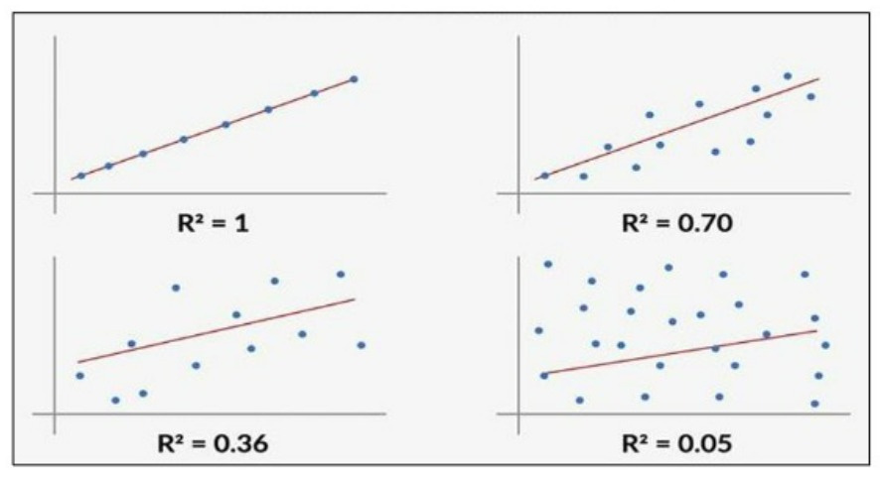


Higher R² and Lower MAE/MSE = Better Model
✅
🚫
Too high MSE or MAE = Model is not accurate enough

Slide 8
QNA
1.What does the Mean AbsoluteError(MAE)indicate in a regression model?
A. The percentage of correct predictions B. The average of the squared differences between actual and predicted values C. The average of the absolute differences between actual and predicted values D. The number of data points used in training
2.Ifamodel has an R² Score of 0.90, what does it imply?
A. The model explains 90% of the variance in the data B. The model has 90% accuracy C. The model makes a 90% correct prediction D. The model has 10% error

